Slide 1
Frequency Domain Filtering

Slide 2
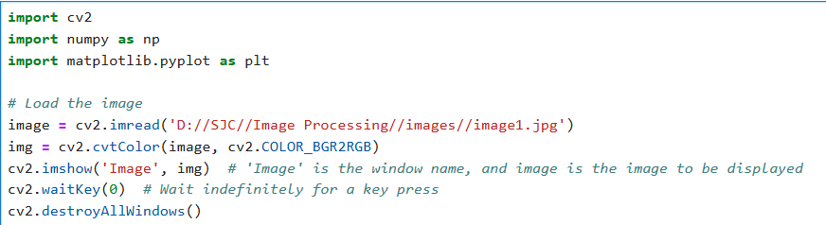
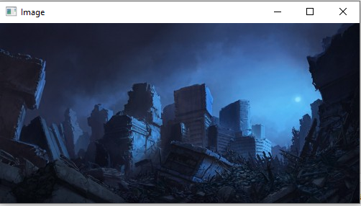

Slide 3
Domain Filter

Slide 4
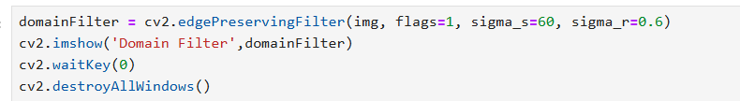
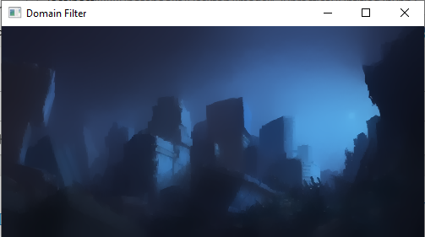

Slide 5
Diff

Slide 6
Gaussian blur
( Gaussian smoothing) is the result of blurring an image by a Gaussian function.
It is a widely used effect in graphics software, typically to reduce image noise and reduce detail. The visual effect of this blurring technique is a smooth blur resembling that of viewing the image through a translucent screen, distinctly different from the bokeh effect produced by an out-of-focus lens or the shadow of an object under usual illumination.

Slide 7
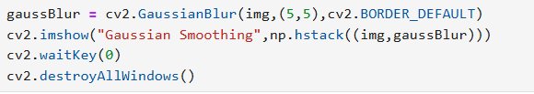
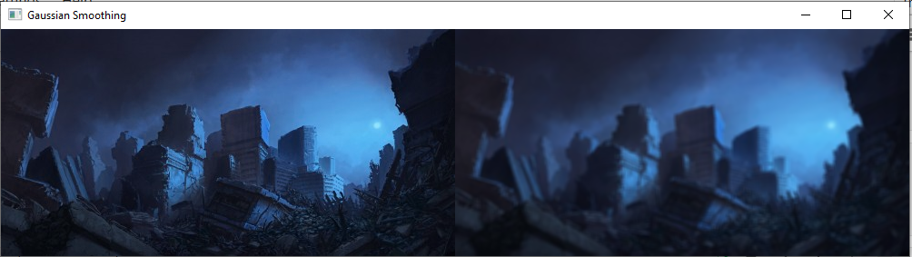

Slide 8
Mean Filtering Techniques
The idea of mean filtering is simply to replace each pixel value in an image with the mean (`average’) value of its neighbours, including itself. This has the effect of eliminating pixel values that are unrepresentative of their surroundings. Mean filtering is usually thought of as a convolution filter. Like other convolutions, it is based around a kernel, which represents the shape and size of the neighbourhood to be sampled when calculating the mean.

Slide 9
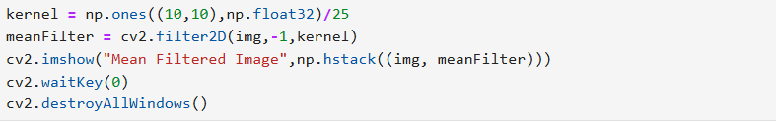
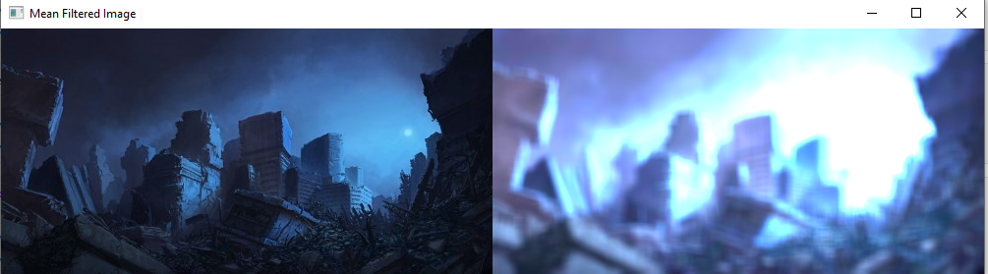

Slide 10
Median Filtering Techniques
Median filtering is a nonlinear process useful in reducing impulsive, or salt-and-pepper noise. It is also useful in preserving edges in an image while reducing random noise. Impulsive or salt-and-pepper noise can occur due to a random bit error in a communication channel. In a median filter, a window slides along the image, and the median intensity value of the pixels within the window becomes the output intensity of the pixel being processed.

Slide 11
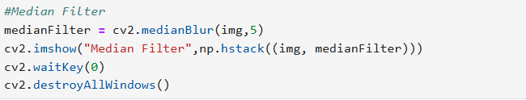
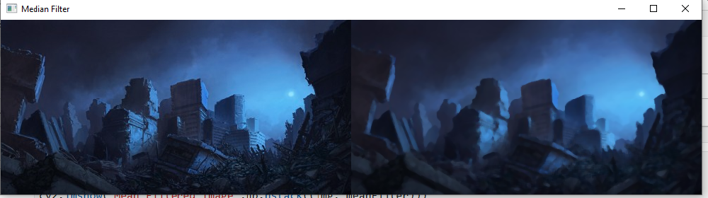

Slide 12
Bilateral Filtering Techniques
A Bilateral filter is a non-linear, edge-preserving, and noise-reducing smoothing filter for images. It replaces the intensity of each pixel with a weighted average of intensity values from nearby pixels. This weight can be based on a Gaussian distribution.
Crucially, the weights depend not only on the Euclidean distance of pixels but also on the radiometric differences (e.g., range differences, such as color intensity, depth distance, etc.). This preserves sharp edges.

Slide 13
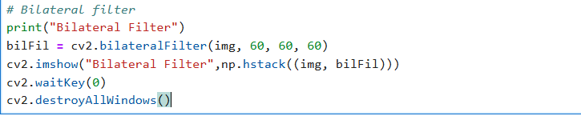
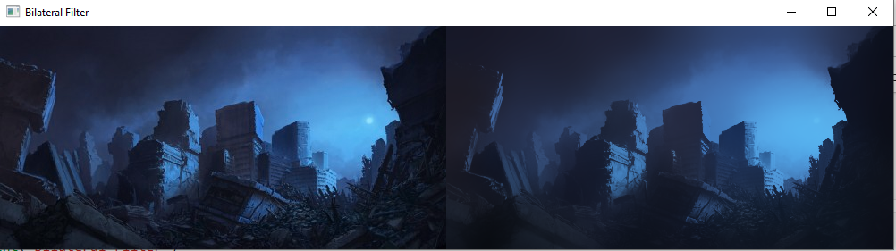

Slide 14
Frequency Band Filtering Techniques
Frequency filters process an image in the frequency domain. The image is Fourier transformed, multiplied with the filter function and then re-transformed into the spatial domain. Attenuating high frequencies results in a smoother image in the spatial domain, attenuating low frequencies enhances the edges.
All frequency filters can also be implemented in the spatial domain and, if there exists a simple kernel for the desired filter effect, it is computationally less expensive to perform the filtering in the spatial domain. Frequency filtering is more appropriate if no straightforward kernel can be found in the spatial domain, and may also be more efficient.

Slide 15
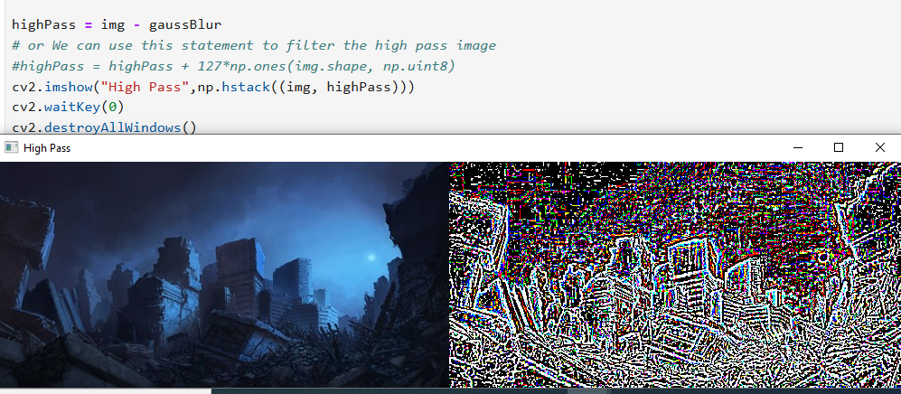

Slide 16
